Slide 1



New Methods in Collision of Bodies Analysis
Ivan Němec, Jiří Vala, Hynek Štekbauer, Michal Jedlička, Daniel Burkart

Slide 2
General Assumptions
New Methods in Collision of Bodies Analysis
Ivan Němec, Jiří Vala, Hynek Štekbauer, Michal Jedlička, Daniel Burkart
Bodies are discretized by linear tetrahedron finite elements
Explicit method is used for the time analysis
In each time step constant velocities and linear relations for displacement are assumed for finding the time and place of a contact
Surfaces of bodies are approximated by triangle plane segments
Discretization of mass into nodes
Displacement and velocity of bodies is given by its nodal values
There are only two kinds of contacts possible
  node to segment
  edge to edge

Slide 3
The explicit method
The method of central diferences
displacement (Taylor’s theorem)
velocity (by subtracting the equations)
acceleration (by additing the equations)
equation of motion
Substituting for and we obtain:
Condition for diagonalization given by the velocity of waves and time step

Slide 4
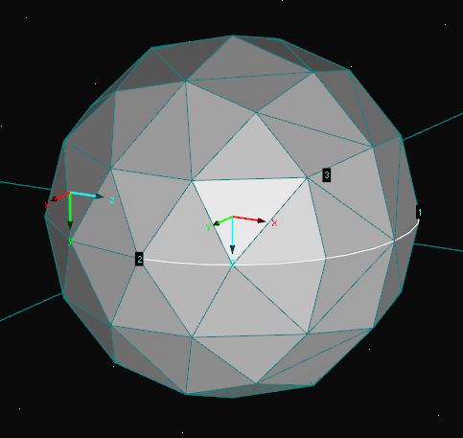
Discretized body surface
Calculation of collisions of bodies by the explicit method

Slide 5
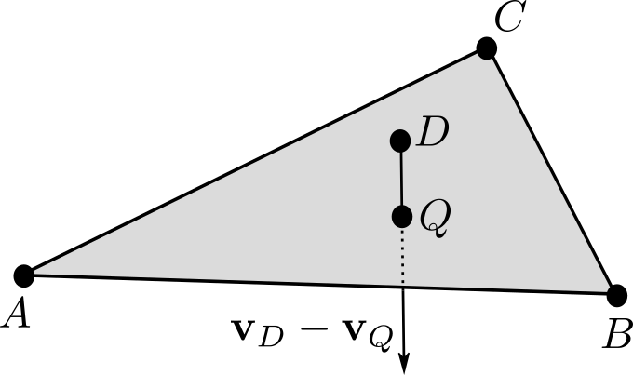
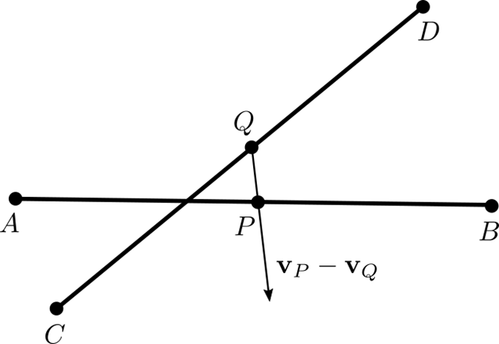
Calculation of collisions of bodies by the explicit method
Finding the time and space coordinates of the collision
Assumption of geometrical linearity in each time step
Assumption of constant velocities in each time step

Slide 6
Assumption of constant velocities in each time step
Condition that the points A, B, C, D lay in one plane
The valid root must satisfy and

Slide 7
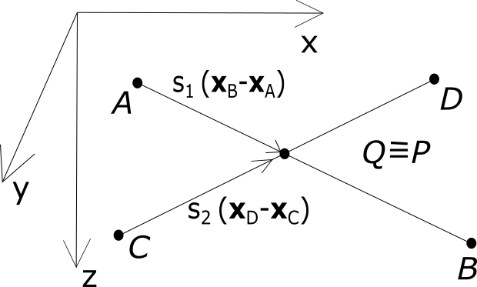
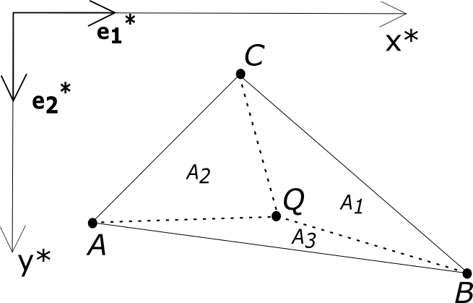
Determination of the positions and velocities of the colliding points
Relation between the colliding points and the nodes A, B, C, D
collision of two line segments, or edges
Solving equation for colliding points P and Q
3 equations for 2 unknowns
Both conditions fulfilled = real collision found
weights of nodes A,B,C,D
collision of a node and a triangle surface segment
colliding points P and Q
weights of nodes A,B,C
Point does not lay inside the triangle

Slide 8
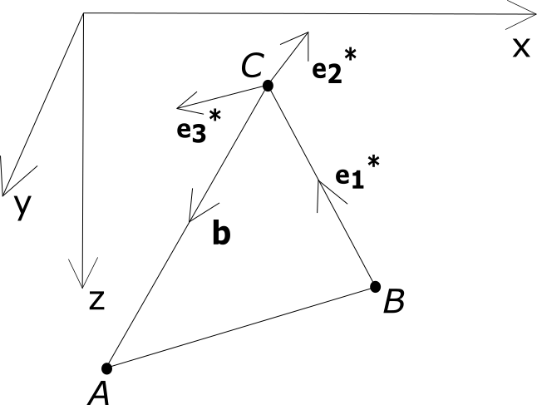
Determination of the contact plane and its property

Slide 9
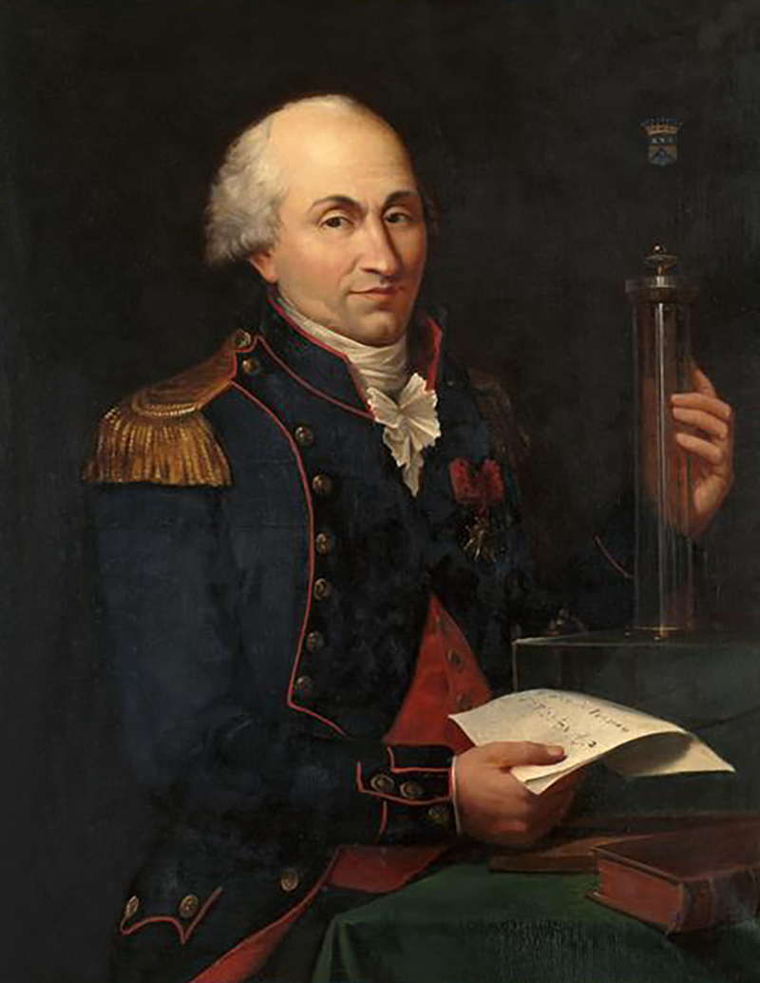
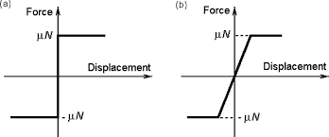
Friction
Charles-Augustin de Coulomb
14 June 1736 – 23 August 1806
French officer, engineer, and physicist

Slide 10
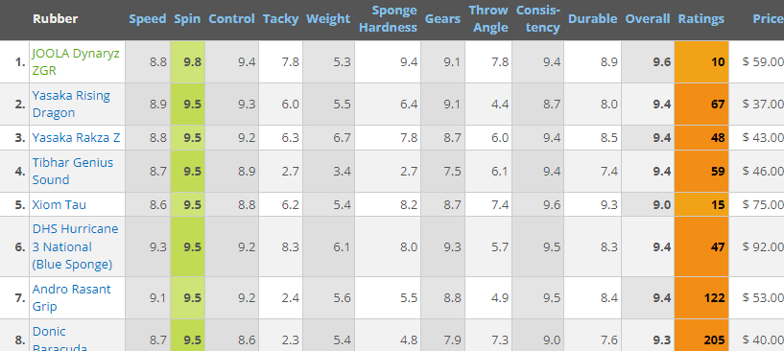
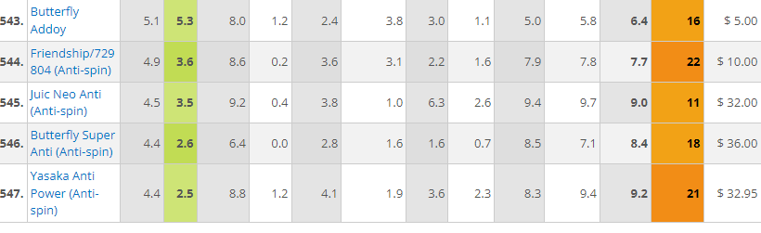

Slide 11
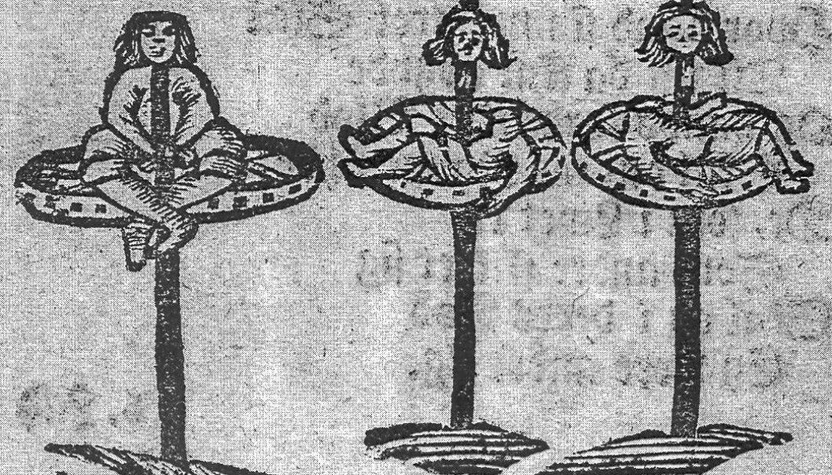
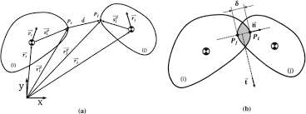
The Penalty Method of impact of bodies

Slide 12
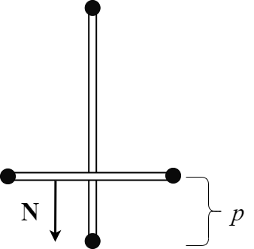
Standard analysis of the collision of bodies
Penalty method
Main features:
Determination of the the contact force proportional to the magnitude of the penetration
Method is based on the breaching of the natural demand of impenetrability
Problematic choise of the stiffness of the contact K
The obtained contact force is rather occational
Poor fulfilling of the conservation of energy
Contact force
Contact stiffness
Penetration
Normal vector to the contact surface

Slide 13
Energy Method
Determination of the direction of the contact force
Absolute friction
Direction of the contact force is the same as the direction of the relative velocity
Zero friction
Direction of the contact force is normal to the contact plane
General friction
Direction of the contact force is the linear combination of the both limit cases

Slide 14
Determination of the magnitude of the contact force
optional dissipated energy
We have one scalar equation so can have only one scalar unknown, the magnitude of the contact force
Conservation of energy
Acceleration by the contact force (point P)
Change of velocity by the contact force (point P)
Acceleration by the contact force (point Q)
Change of velocity by the contact force (point Q)

Slide 15
Relation between the contact force and the pertinent nodal forces
Collision of two line segments, or edges
equivalence of forces
moments equilibrium to the colliding points
relation between contact and nodal forces by weight coefficients

Slide 16
Relation between the contact force and the pertinent nodal forces
Collision of a node and a triangle surface segment
equivalence of forces assuming parallelism of contact and nodal forces
equivalence of moments to the origin
collision of points P and Q
Substitution and reduction by
relation between contact and nodal forces by weight coefficients, calculated from the equations above

Slide 17
Velocities and displacements after the impact as the function of the contact force
Increment of velocity
Velocity after the impact
Increment of displacement
Displacement after the impact

Slide 18
Expressions of the change of energy components caused by the impulse of the contact force during one time step
change of the kinetic energy
change of the elastic potential energy
Work of nodal forces of affected element nodes on the nodal displacements
change of the potential energy of the position
Work of external nodal forces of affected nodes on the nodal displacements

Slide 19
Calculation of the magnitude of the contact force
One unknown scalar parameter
Solution by the Newton method
Initial values for iterations (the elastic energy omitted)
(generic quadratic equation)
Numerical approximation of the first derivation
Iteration algorithm
Solution of the f and its first derivative is obtained from the anlytical solution of quadratic equation

Slide 20
Energy method - conclusions
Exact fullfilness
  Conservation of mass
  Conservation of energy
  Conservation of momentum
Simple simulation of the „elastic friction“
Simple involving dissipation
Disipated energy

Slide 21
Kinematic Method
The fundamental assumption of the kinematic method of collision of bodies is the condition of impenetrability of bodies
The unknown vectors of velocities of the points
Total 12 unknown scalar values
Determination of velocities vectors of the colliding points after the impact
Transformation of velocities to the contact plane

Slide 22
Absolute friction
Conservation of momentum – 6 equations
Conservation of linear momentum, (3 equations)
Conservation of angular momentum, (3 equations)
Kinematic conditions – 3 equations
Collision of a node and a triangle, angular velocity all the triangle nodes are the same
Angular momentum
Angular velocity
absolute friction
Only 3 equations can be taken due to linear independency
Collision of two line segments, conservation of angular momentum of both lines to the colliding points
Only 3 equations can be taken due to linear independency

Slide 23
Contact condition, influence of friction – 3 equations
absolute friction
two lines
node and triangle

Slide 24
Zero friction
Velocity components parallel to the contact plane remains the same as before the collision - 8 equations
Conservation of linear momentum normal to the contact plane
1 equation
Conservation of angular momentum to the 2 axes lying in the contact plane
2 equations
Contact condition – velocity components of the colliding points P and Q, normal to the contact plane, are after the impact the same
Collision of two lines
1 equation
Collision of node and triangle

Slide 25
Real friction
absolute friction
zero friction
real friction

Slide 26
Transformation of velocities to the global coordinates

Slide 27
Kinematic method - conclusions
Exact fullfilness
  Conservation of mass
  Conservation of momentum
  Condition of impenetrability
Simple simulation of the „elastic friction“
Good fullfilness of conservation of energy

Slide 28
Examples

Slide 29
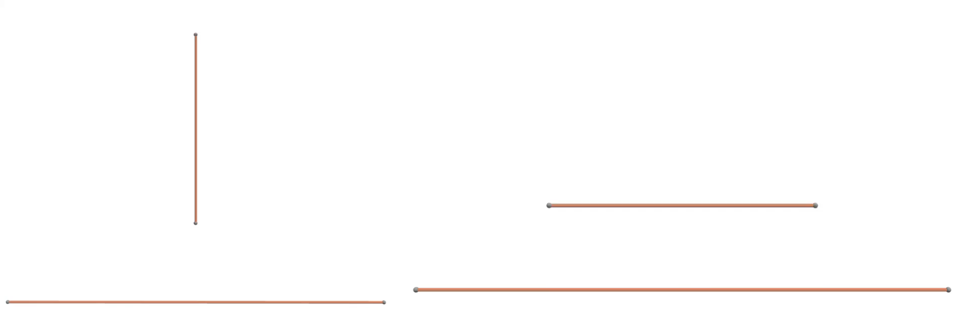
Energy method
kinetic potential elastic total

Slide 30
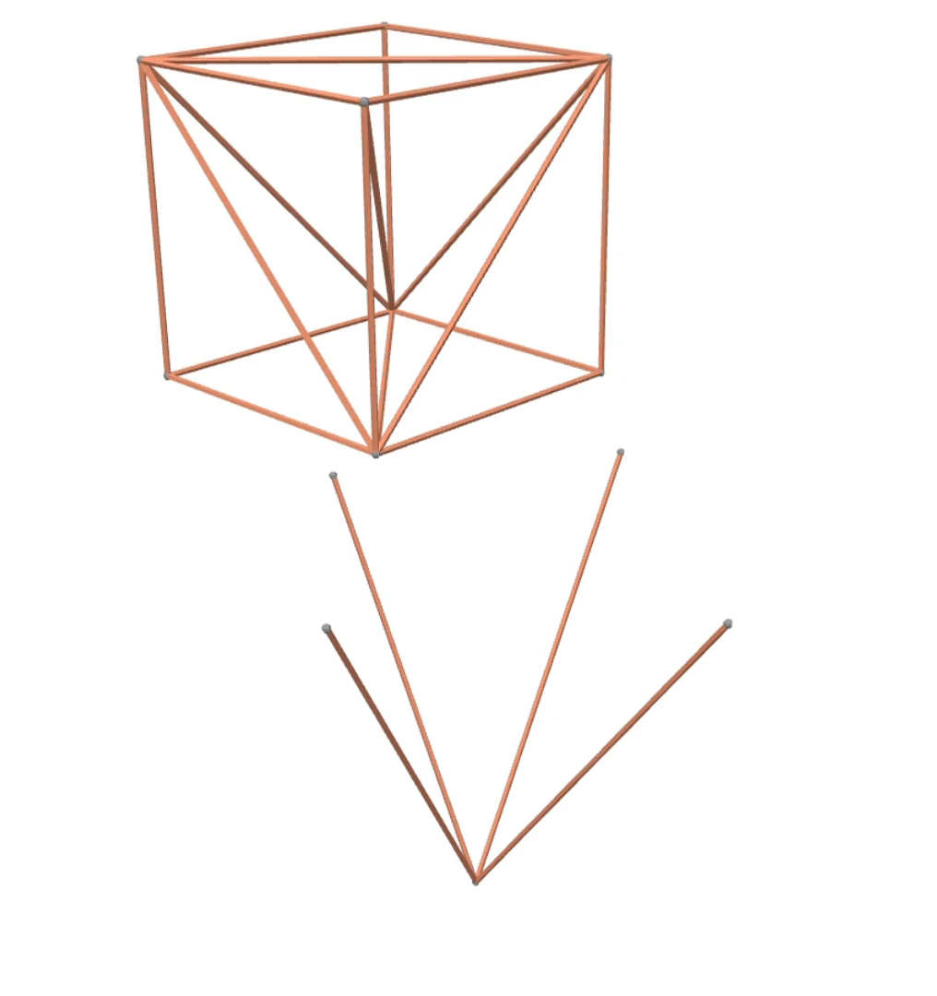
Energy method

Slide 31
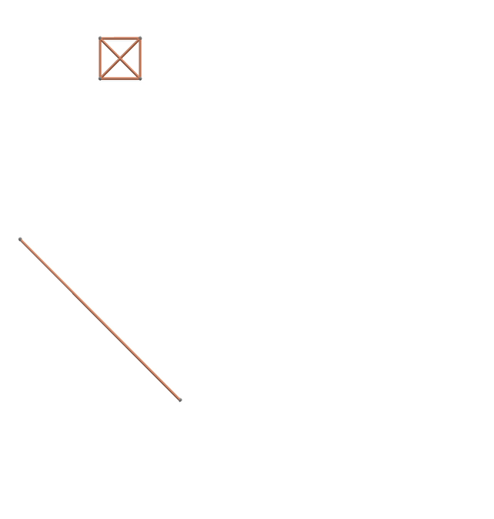
Zero friction

Slide 32
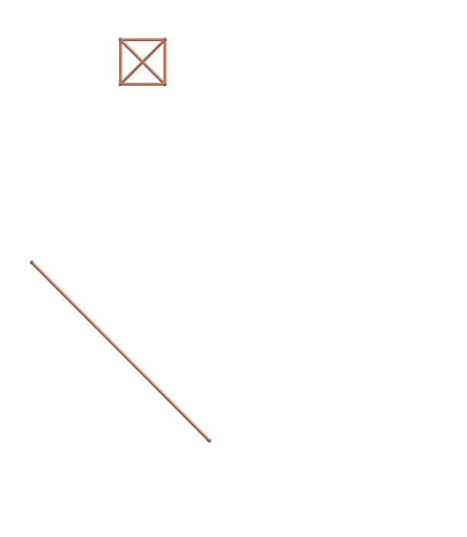
Absolute friction

Slide 33
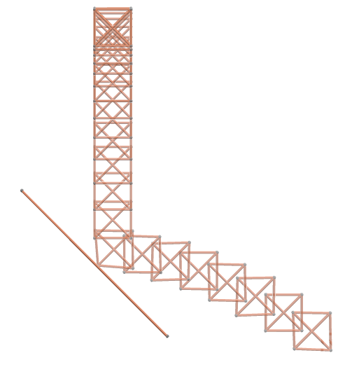
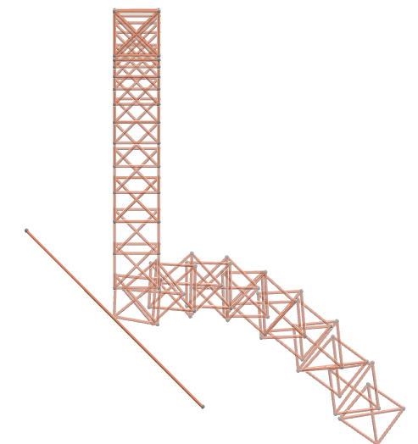
kinetic potential elastic total
kinetic potential elastic total

Slide 34
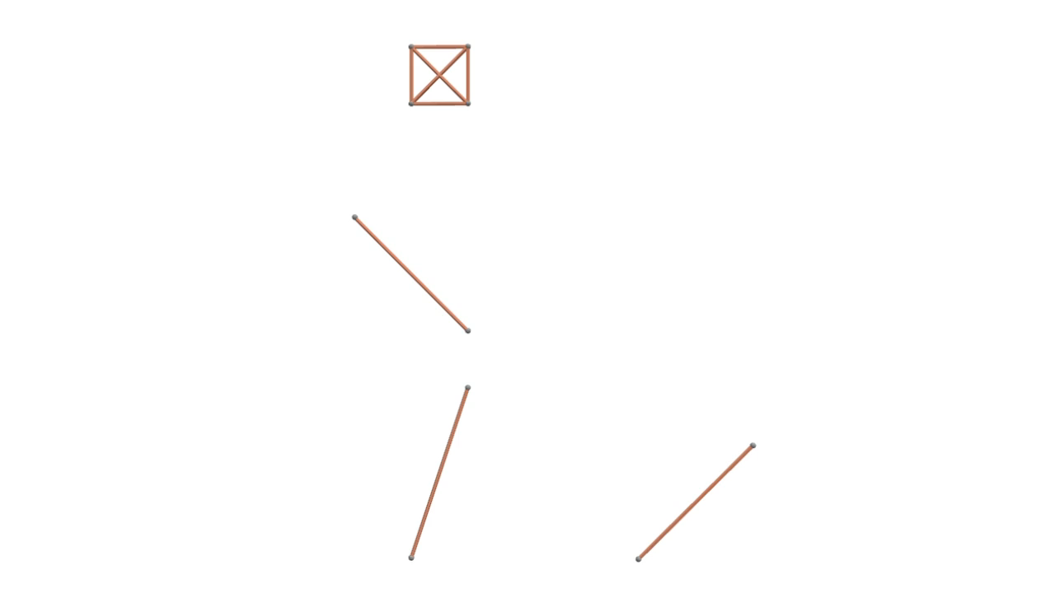

Slide 35
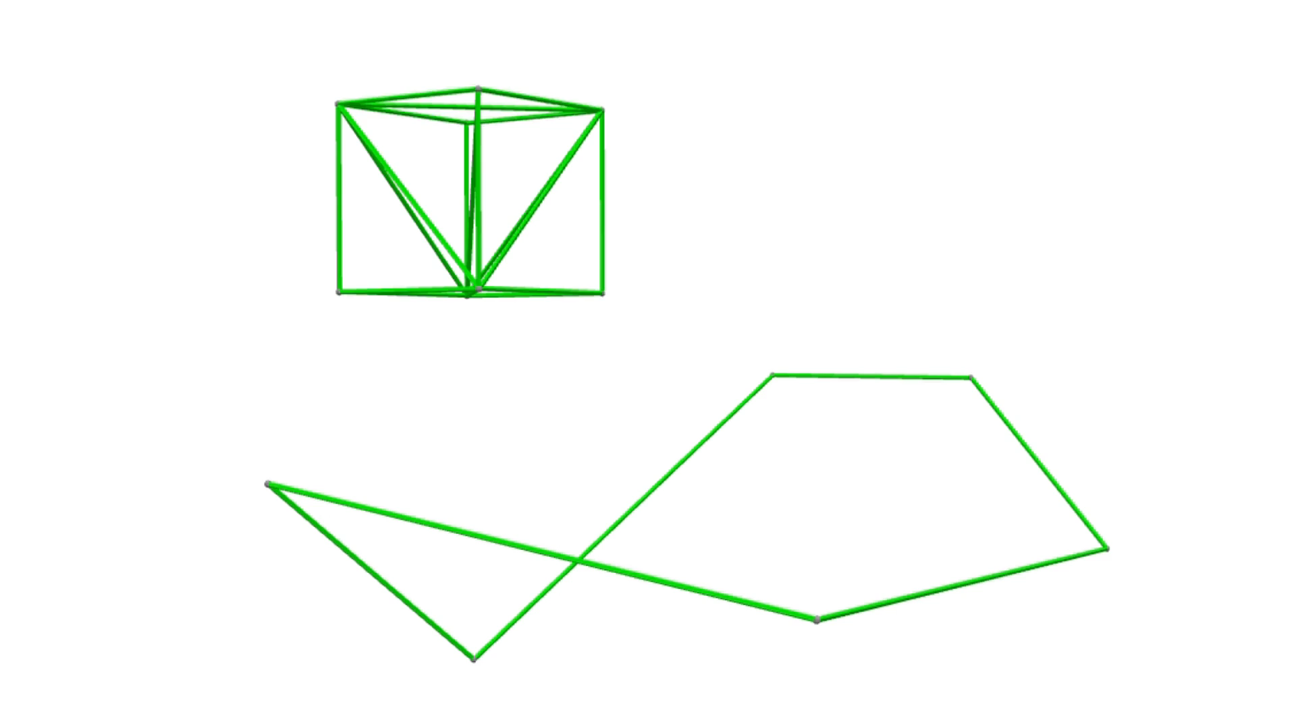

Slide 36
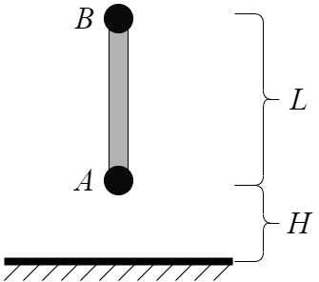
Comparison with the penalty method
Truss member falling to an rigid obstacle
Data from the paper „A variational principle for dynamic contact with large deformation“ (Shen R. Wu, 2009)
Comparison of the energy method and the penalty method with various stiffness parameters
L = 2000mm, H = 0,2mm

Slide 37
Energy method
Node A Node B
kinetic potential elastic total

Slide 38
Kinematic method
Node A Node B
kinetic potential elastic total

Slide 39
Penalty method

Slide 40
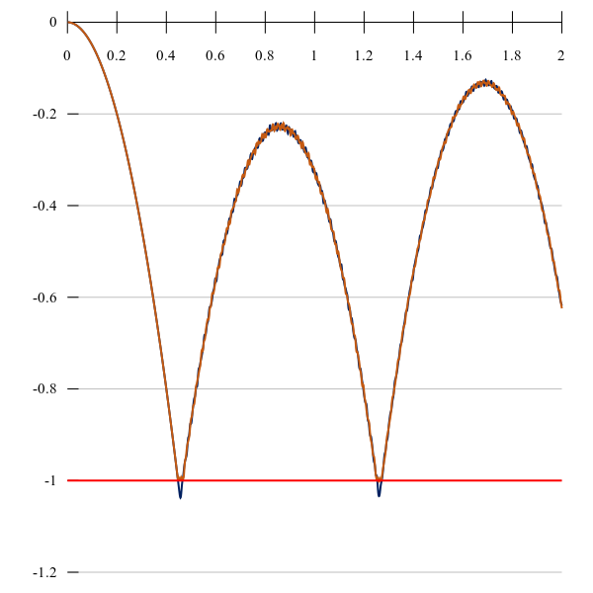
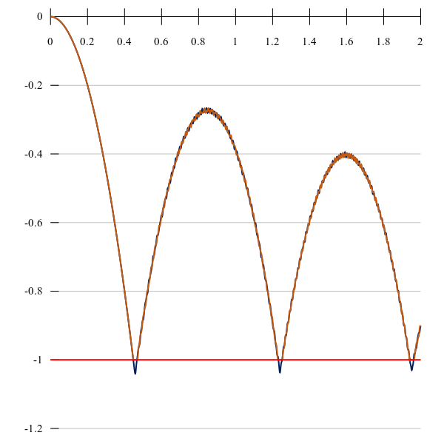
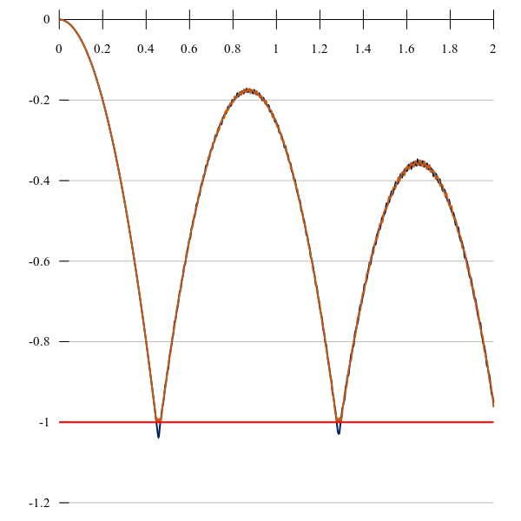
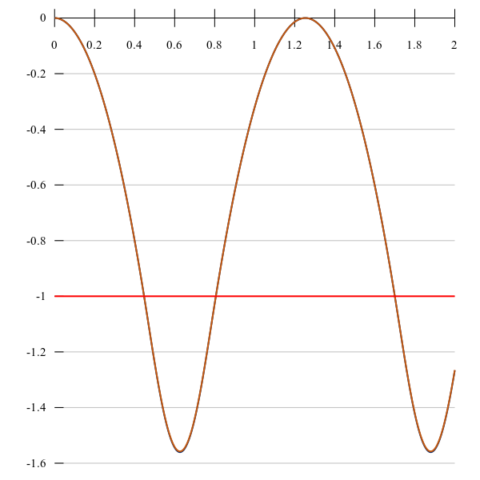
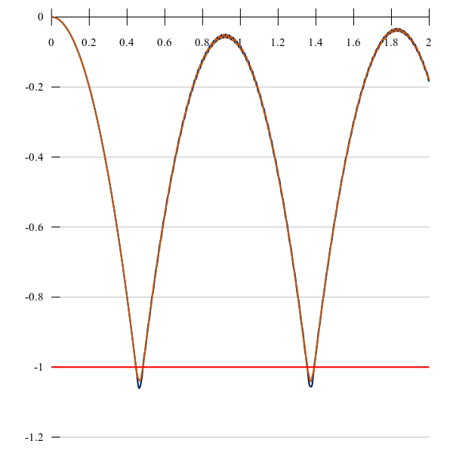
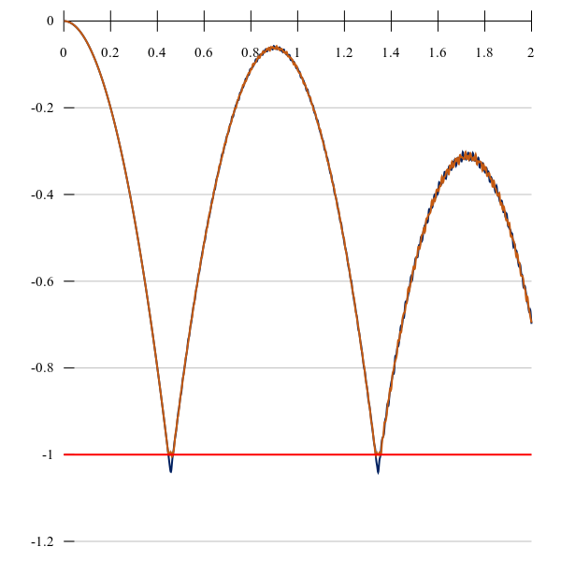
energy
kinematic
penalty K=10000000000
penalty K=10000
penalty K=1000000
penalty K=100000000

Slide 41
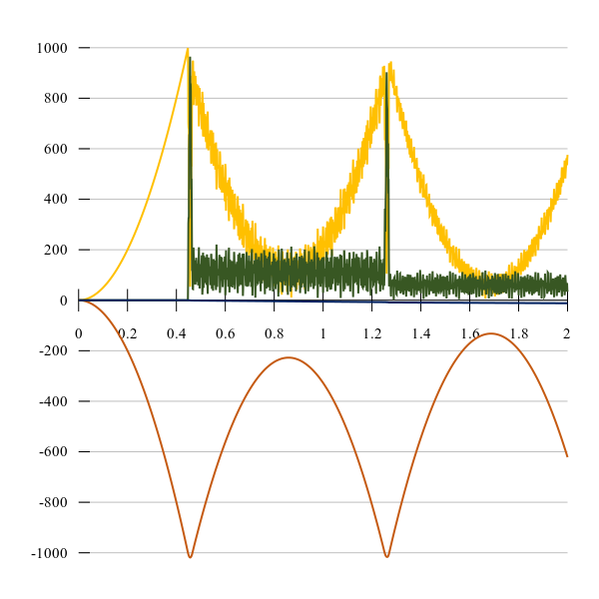
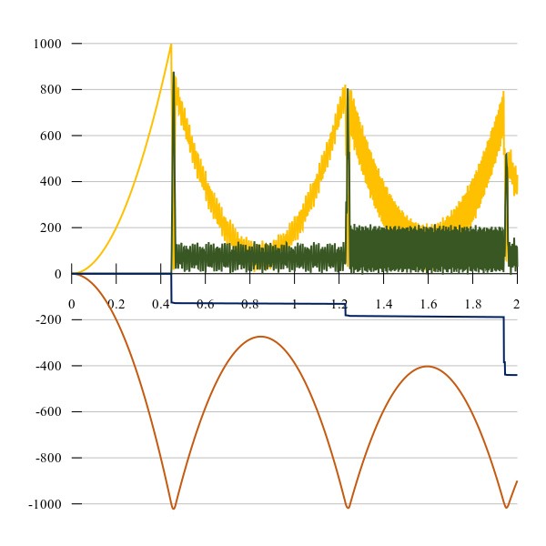
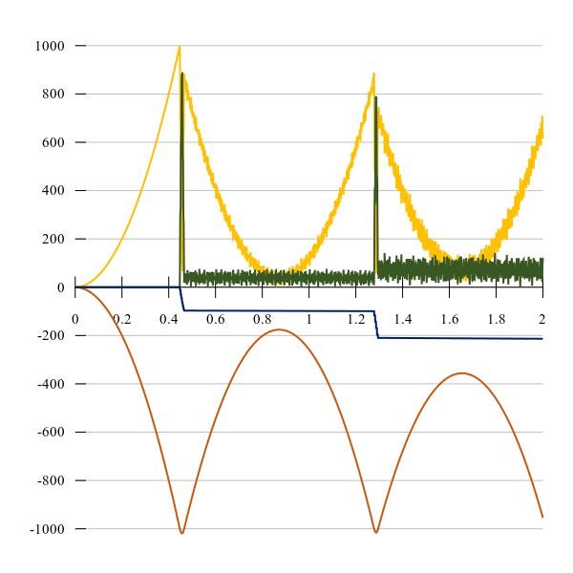
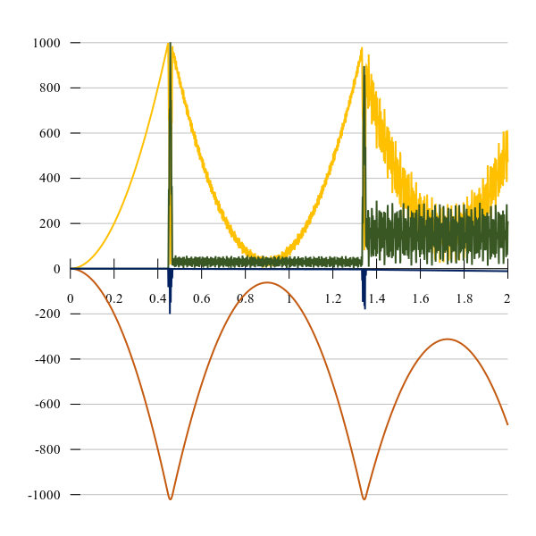
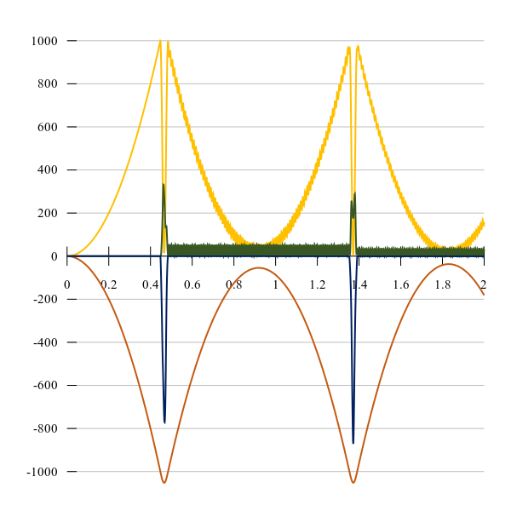
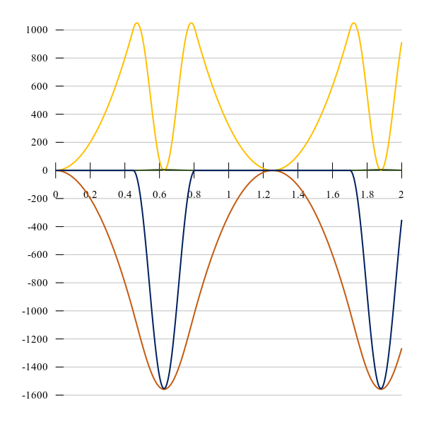
energy
kinematic
penalty K=1000000000000
penalty K=10000
penalty K=1000000
penalty K=100000000
kinetic potential elastic total

Slide 42
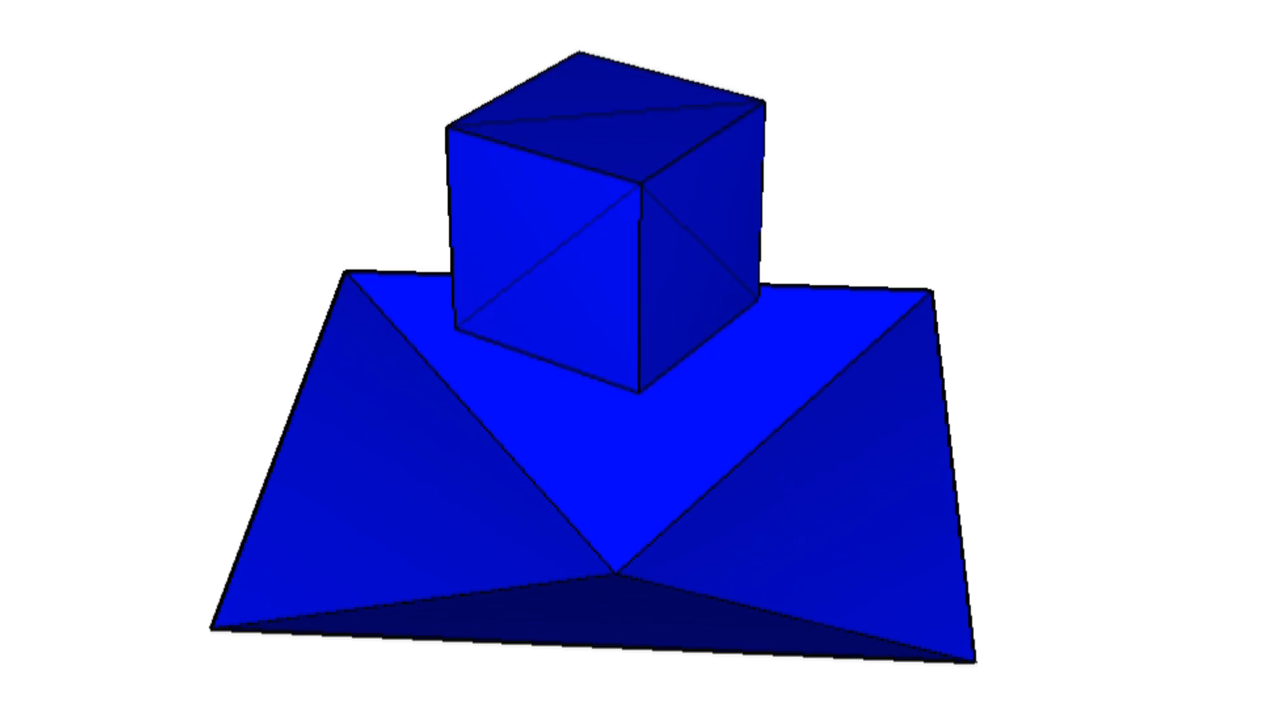
Zero friction

Slide 43
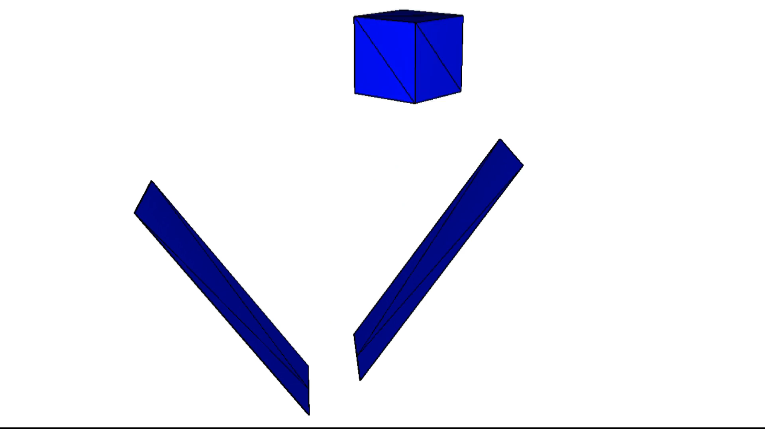
Zero friction

Slide 44
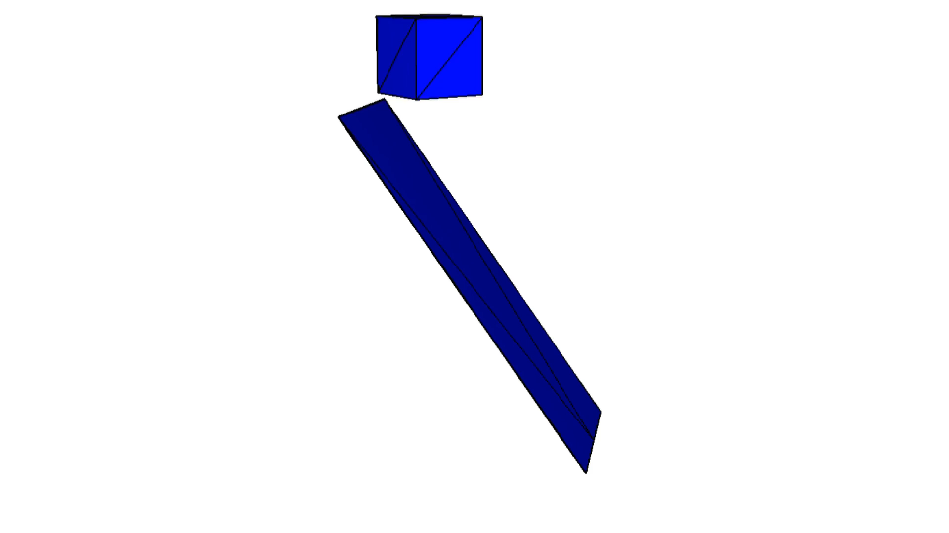
Zero friction

Slide 45
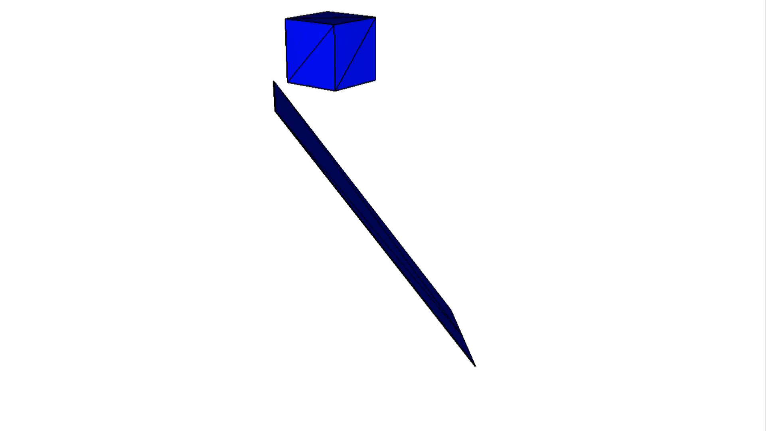
Absolute friction

Slide 46
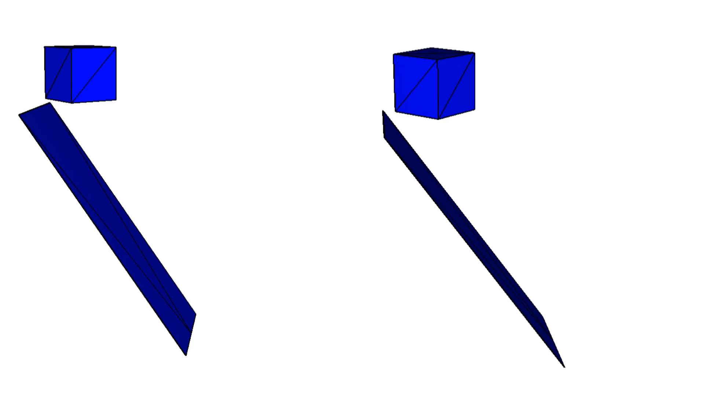
zero friction
absolute friction

Slide 47
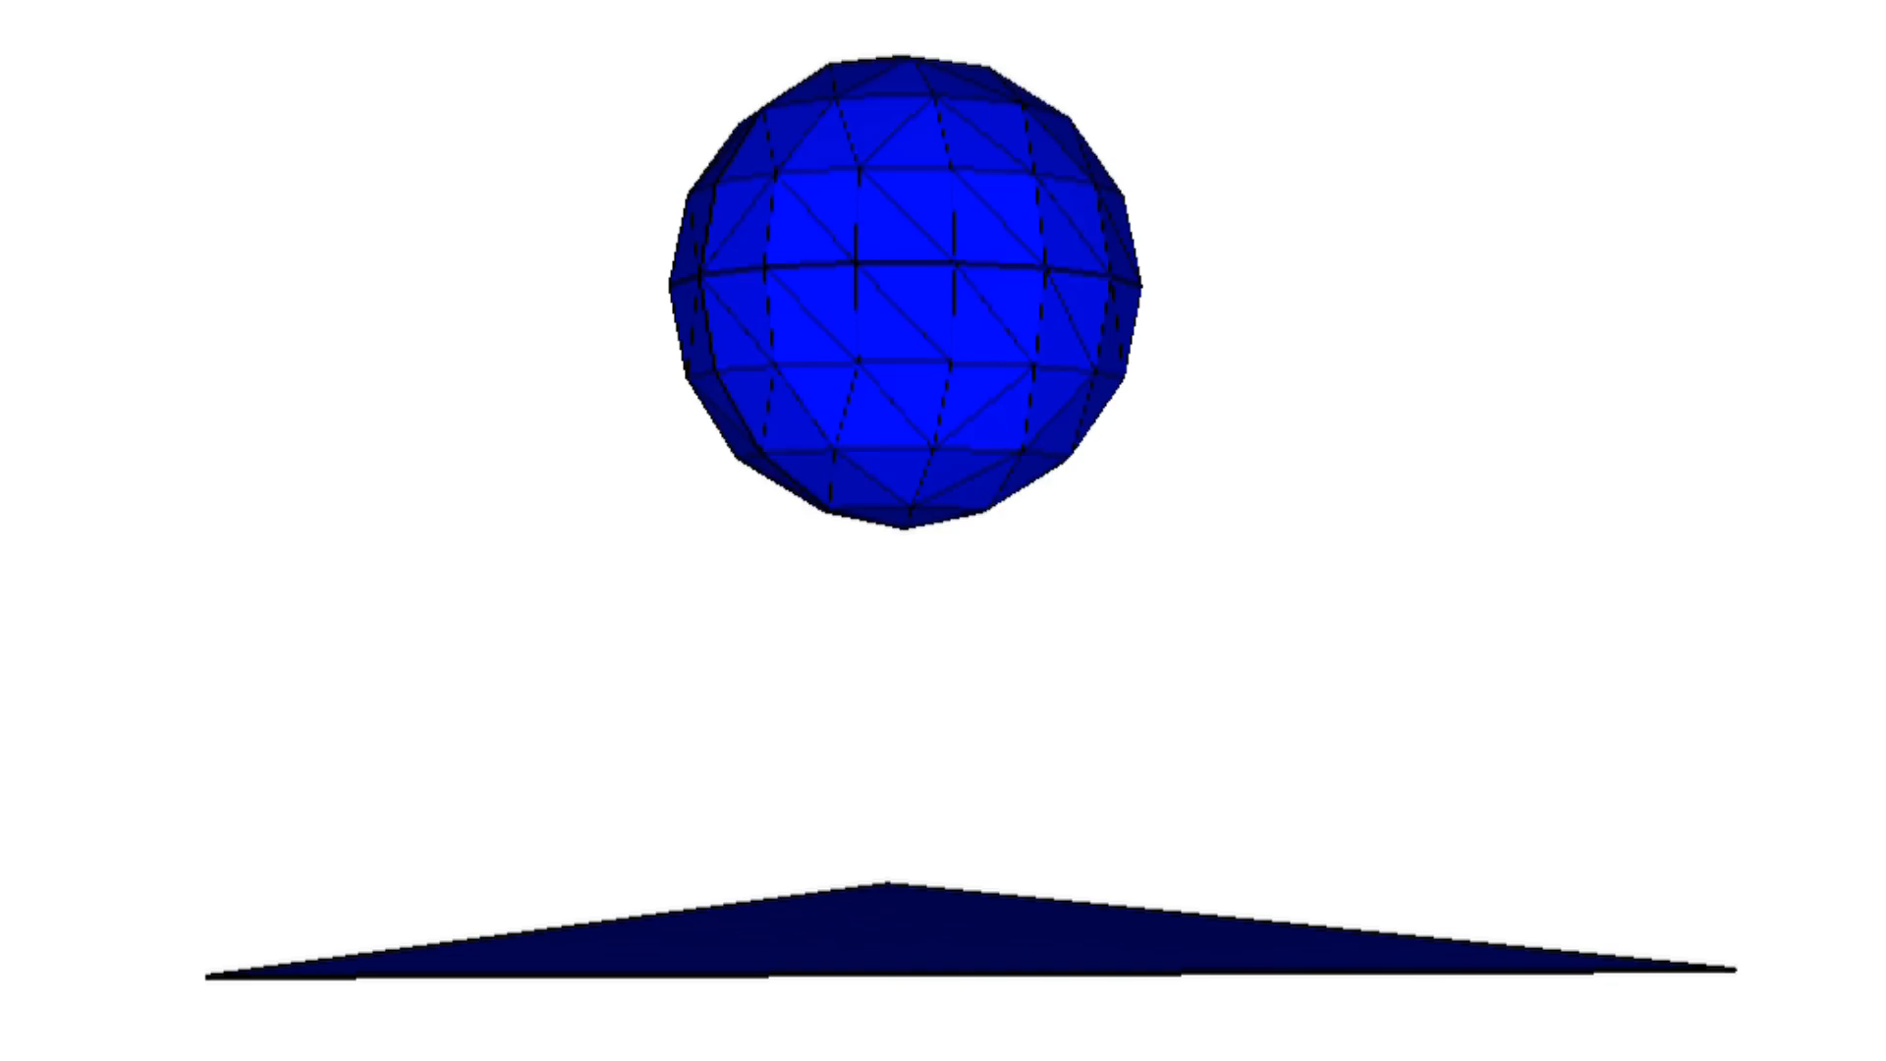

Slide 48
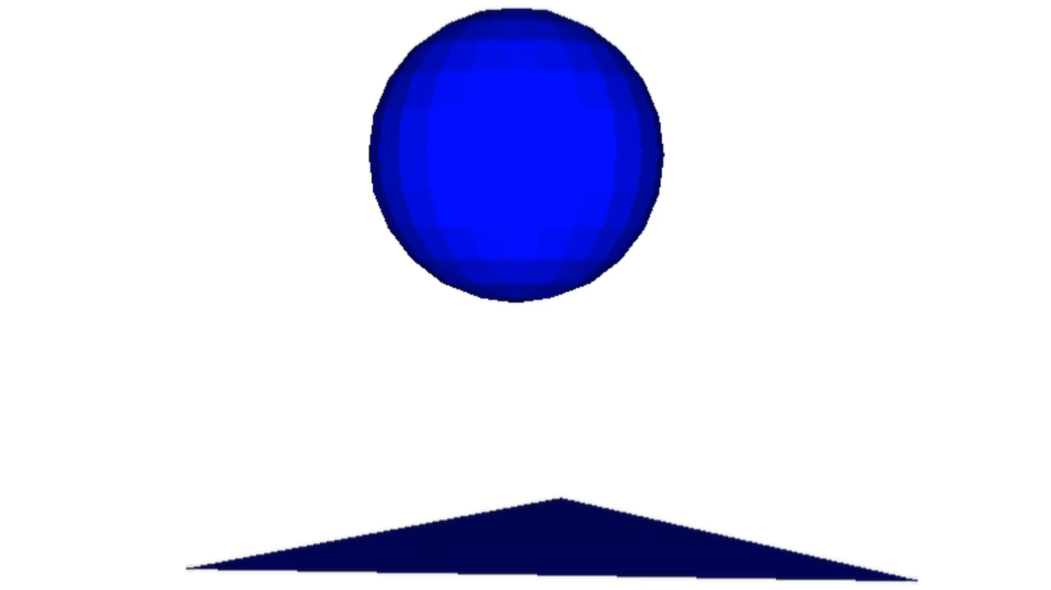

Slide 49
Thank you for your attention

